Slide 1
Detect Credit Card Payment Default By Customer Using CRSIP-DM Methodology And RapidMiner
Date : 5- Aug -2020
Data Mining - CA2 : Group C
Aditya Patange - 10542615
Amol Wadke - 10543430
Tanmay Bane - 10544081

Slide 2
Introduction
The motive of the project is to predict whether the Credit Card Customer will default in making payment next month using CRISP-DM methodology
The phases of the methodology is as follows:
Business Understanding
Data Understanding
Data Preparation
Modelling
Evaluation
Deployment

Slide 3
1. Business Understanding
Understanding key success factors of Credit Card Issuing organization and Banks.
Helping the Credit Card Issuing organization and Bank to assess and forecast customer payment profile.
Assess risk associated with individual customers of making timely payment.
Prediction from solution will help bank to plan mitigation in case of default by taking step to recover payment.
Insights from prediction can help Banks and Credit Card issuers to identify change in market demand to introduce new product.
Bank and Credit Card Issuing organization can create reward schemes to attract new customer and retain existing customers

Slide 4
2. Data Understanding
Dataset used here is a Credit card Dataset.
This dataset contains information on Customer Credit Card Payments, demographic factors, credit data, history of payment, and bill statements of credit card clients in Taiwan from April 2005 to September 2005.
There are 25 attributes in dataset with 30,000 records
https://www.kaggle.com/uciml/default-of-credit-card-clients-dataset

Slide 5
3. Data Preparation
Data Preparation is carried out in order to filter data and make it accurate to perform operations.
Data Preparation consists of the following steps.
Convert Numeric fields to Binomial as applicable
Removal of Duplicate rows from dataset
Set Role –Set Target field in dataset (default.payment.next.month)
Exclude attributes from dataset with high negative and positive co-relation

Slide 6
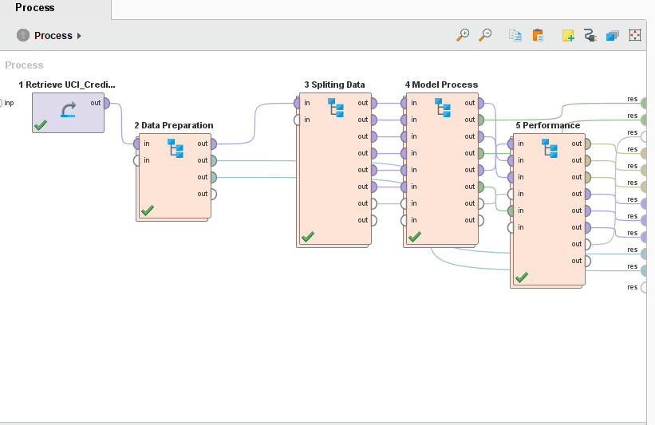
Overall Solution
The process consists of 5 phases:
Data Retrieve
Data Preparation
Splitting Data
Model Process
Algorithm for Performance Calculation

Slide 7
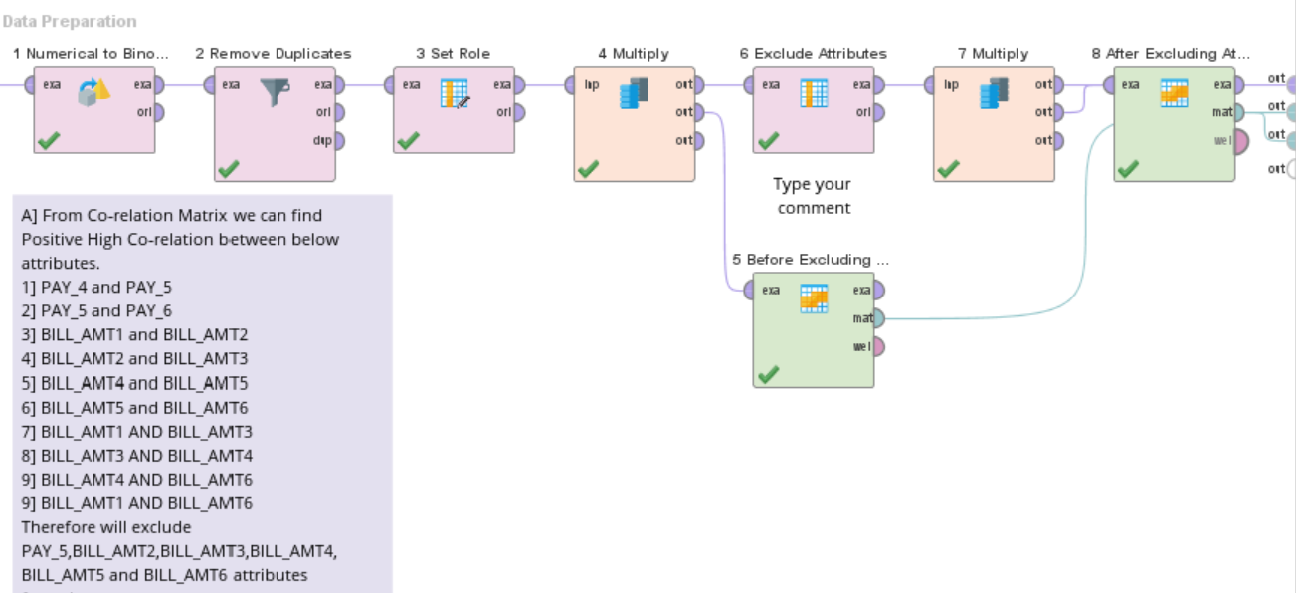
Data Preparation
Data Preparation Steps:
Numerical to Binomial conversion of values
Remove duplicate values
Set Role
Exclude Attributes

Slide 8
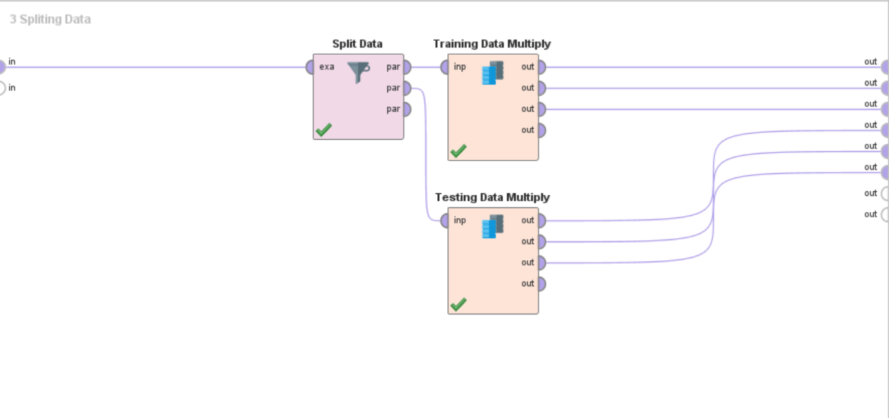
Split Data
Splitting of Data:
Split Data allows to perform Cross Validation. It can be Achieved by enumerating the partitions(Training and Test)

Slide 9
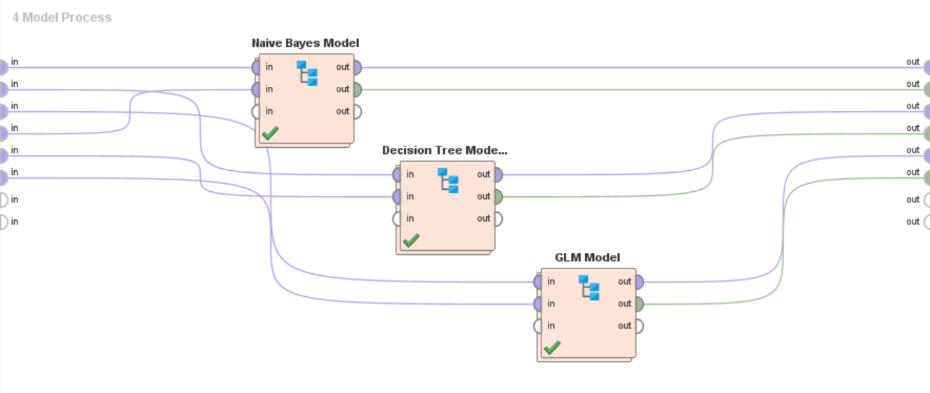
4. Modelling
Algorithms applied are as follows:
Naive Bayes Algorithm
Decision Tree Model
Generalised Linear Model Algorithm

Slide 10
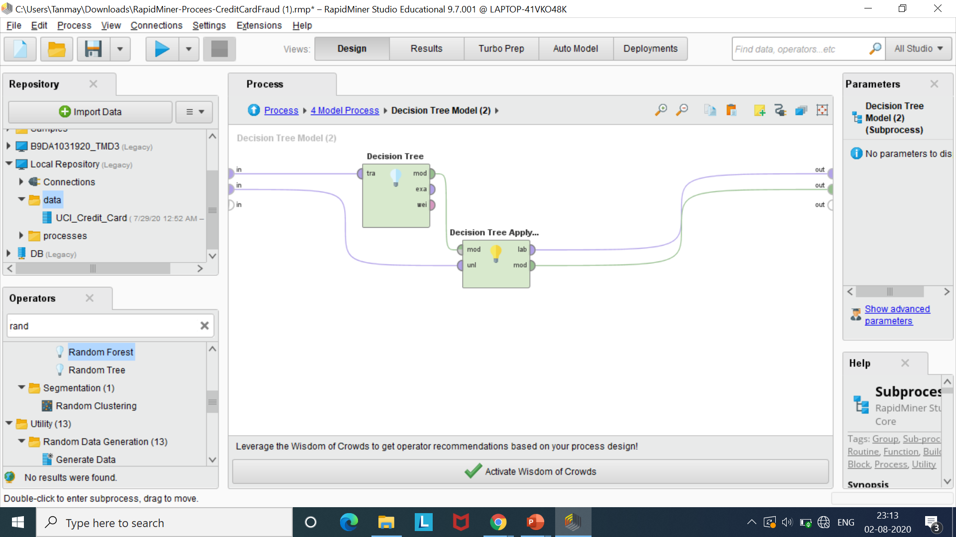
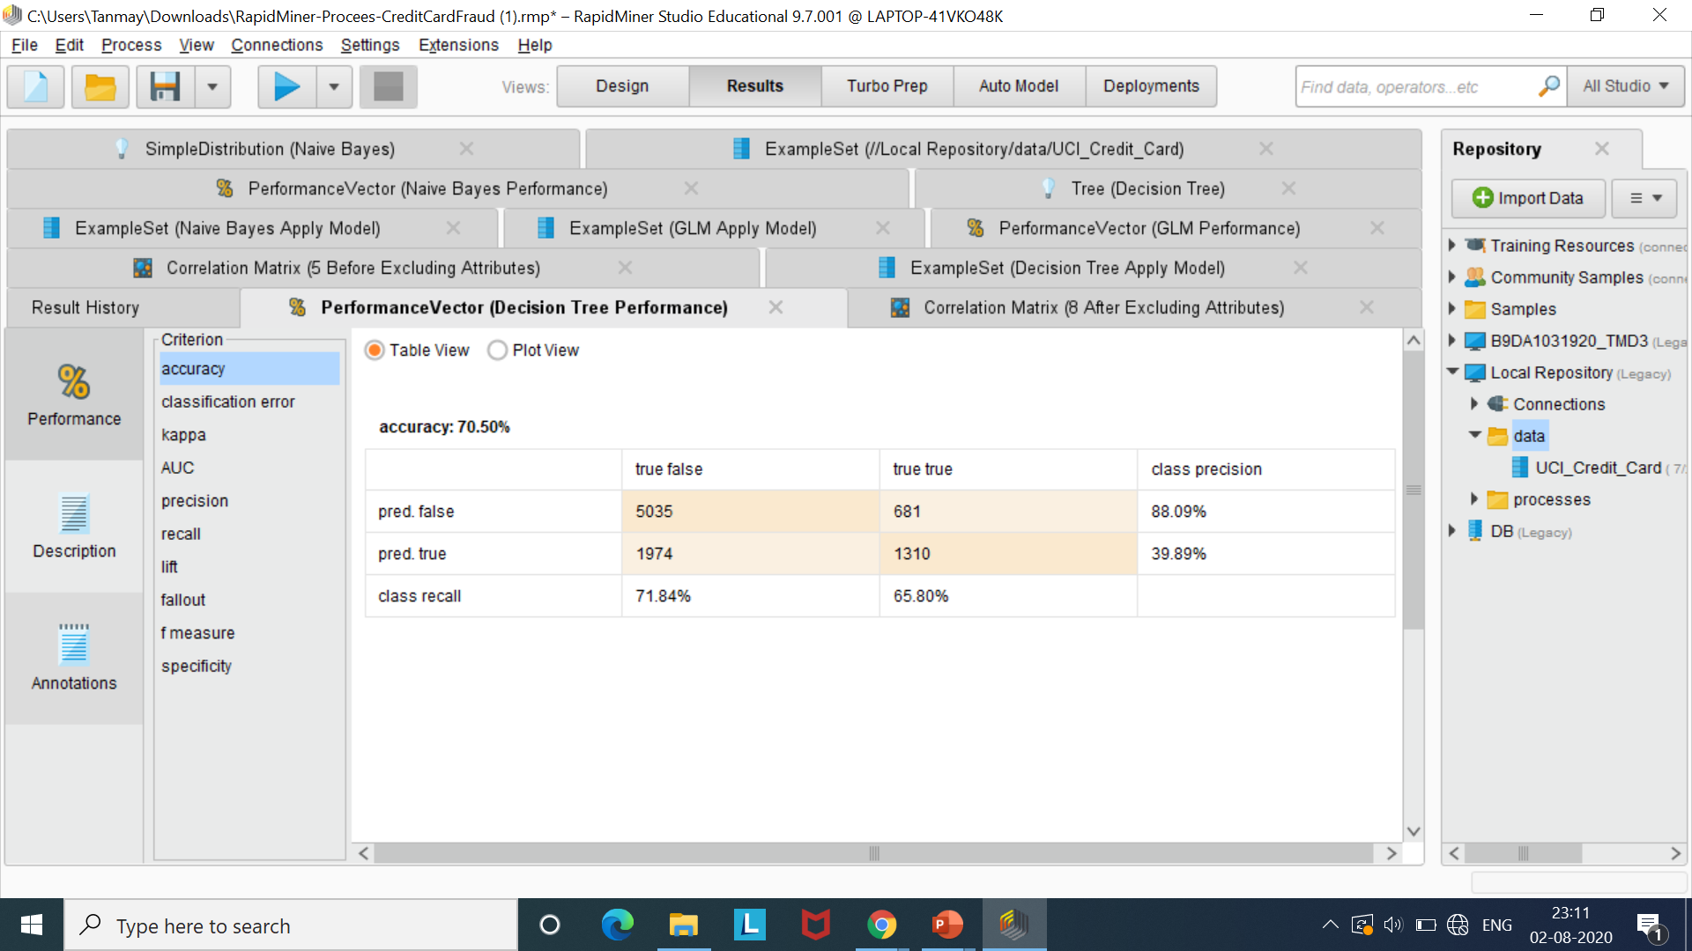
5. Evaluation- Performance of Decision Tree Model
Decision Tree Model:
Accuracy achieved by Decision Tree Model is 70.50%

Slide 11
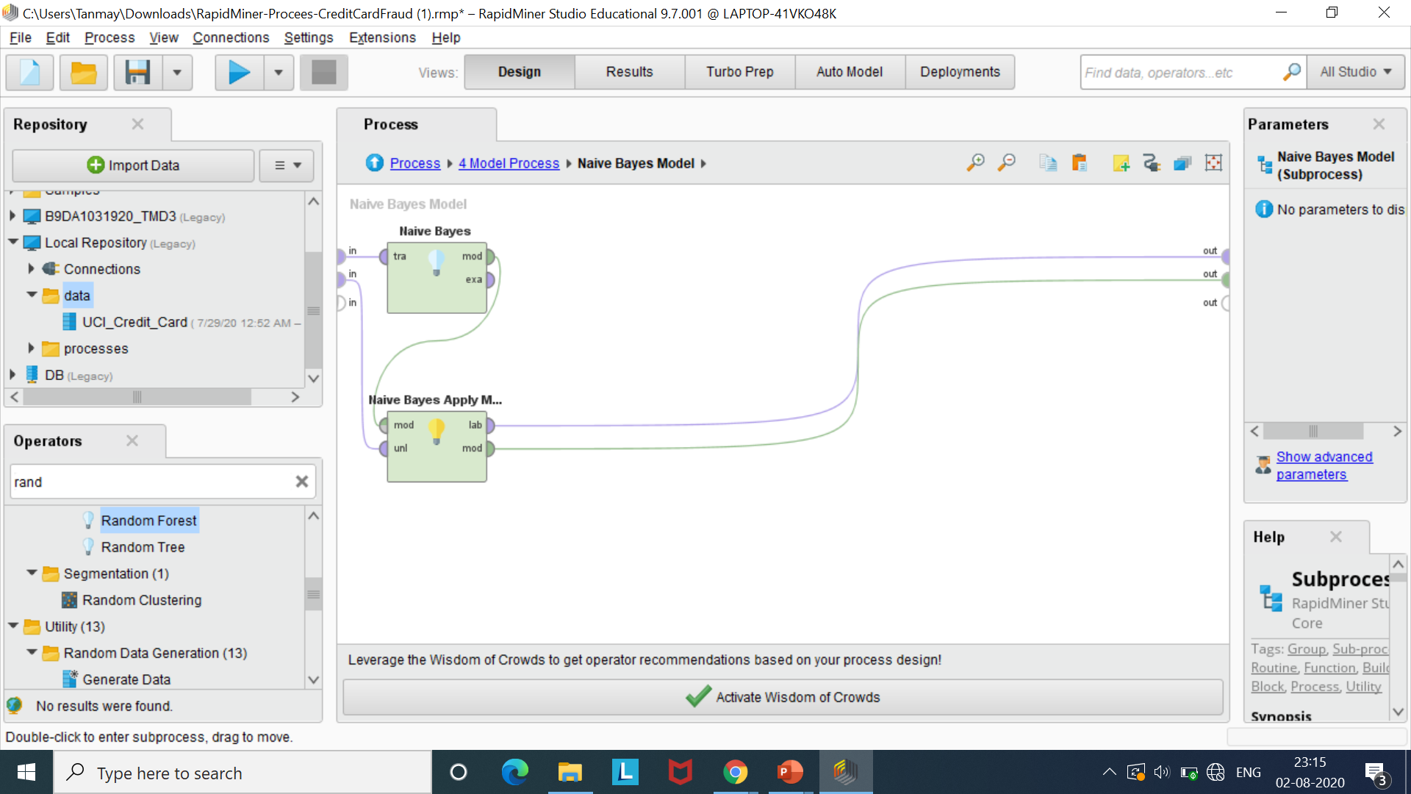
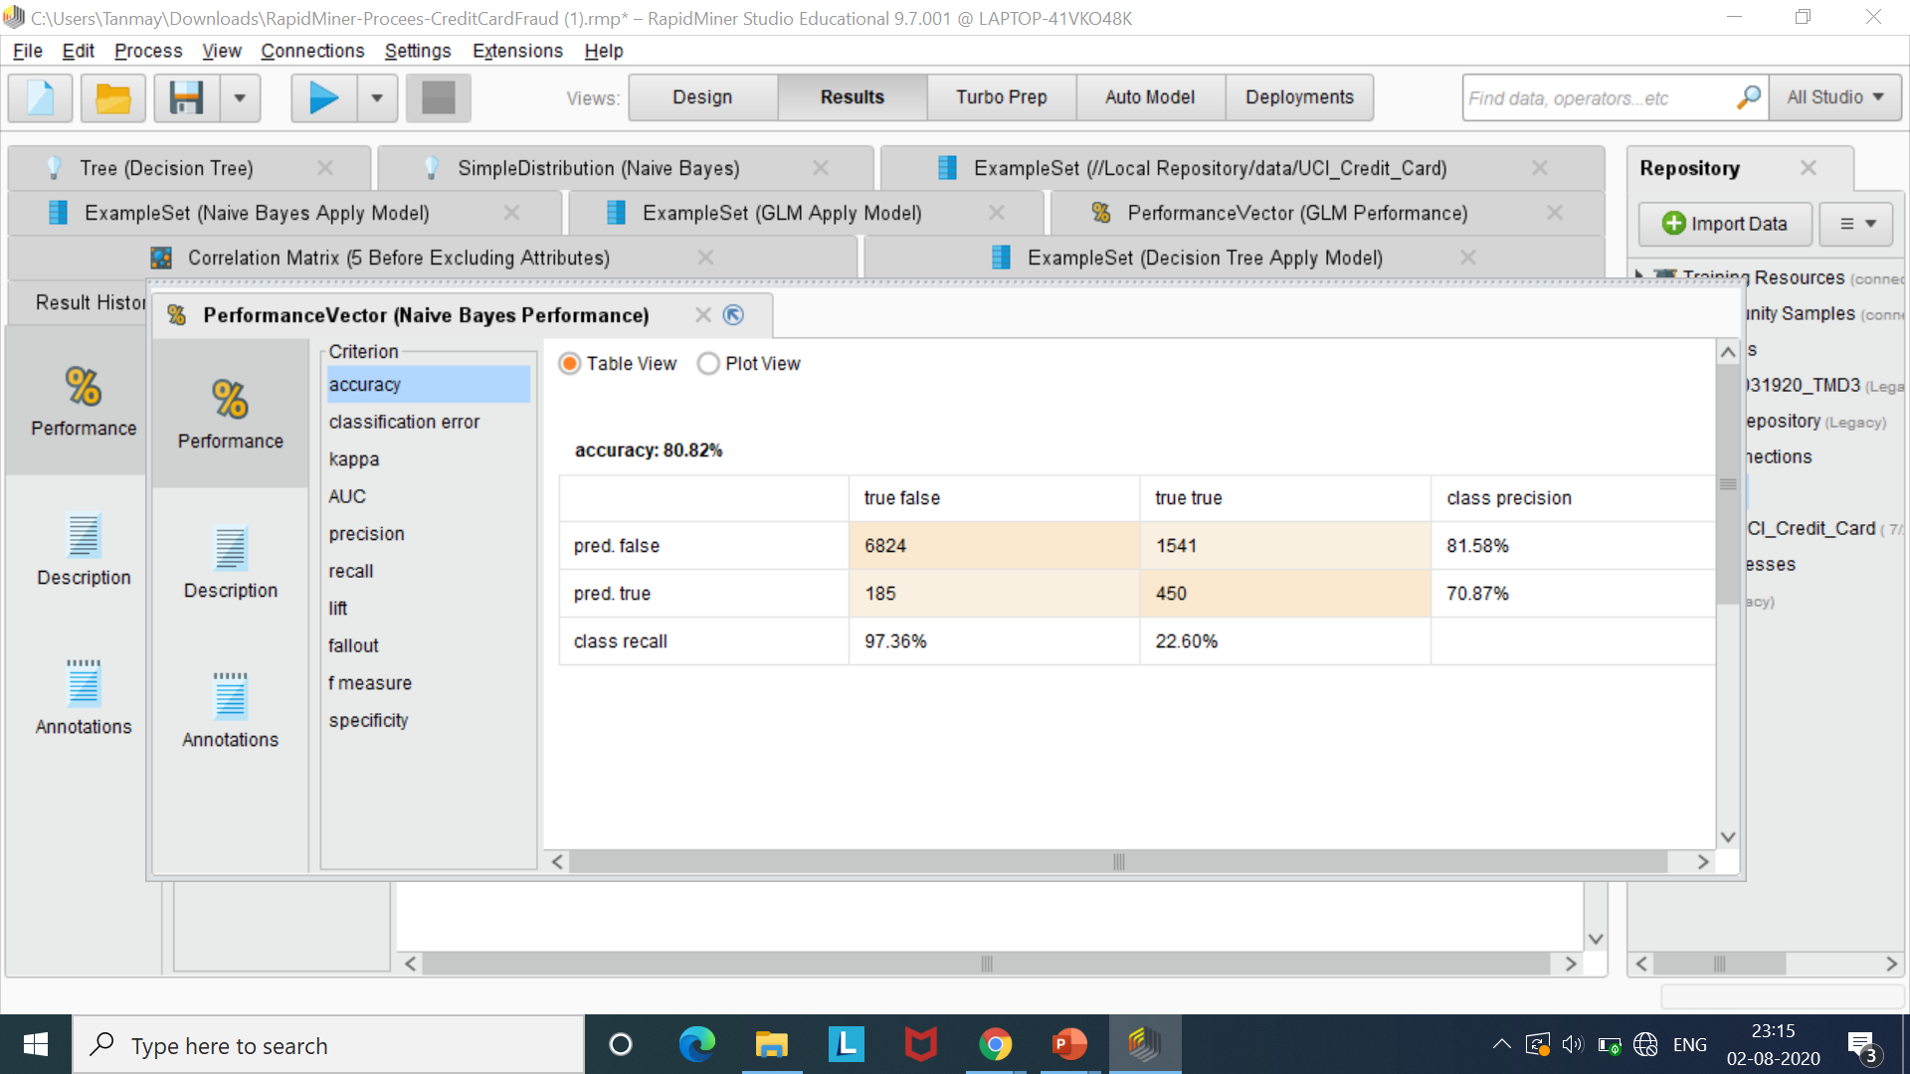
Evaluation - Performance of Naïve Bayes Model
Naïve Bayes Model:
Accuracy achieved by Naïve Bayes Model is 80.82%

Slide 12
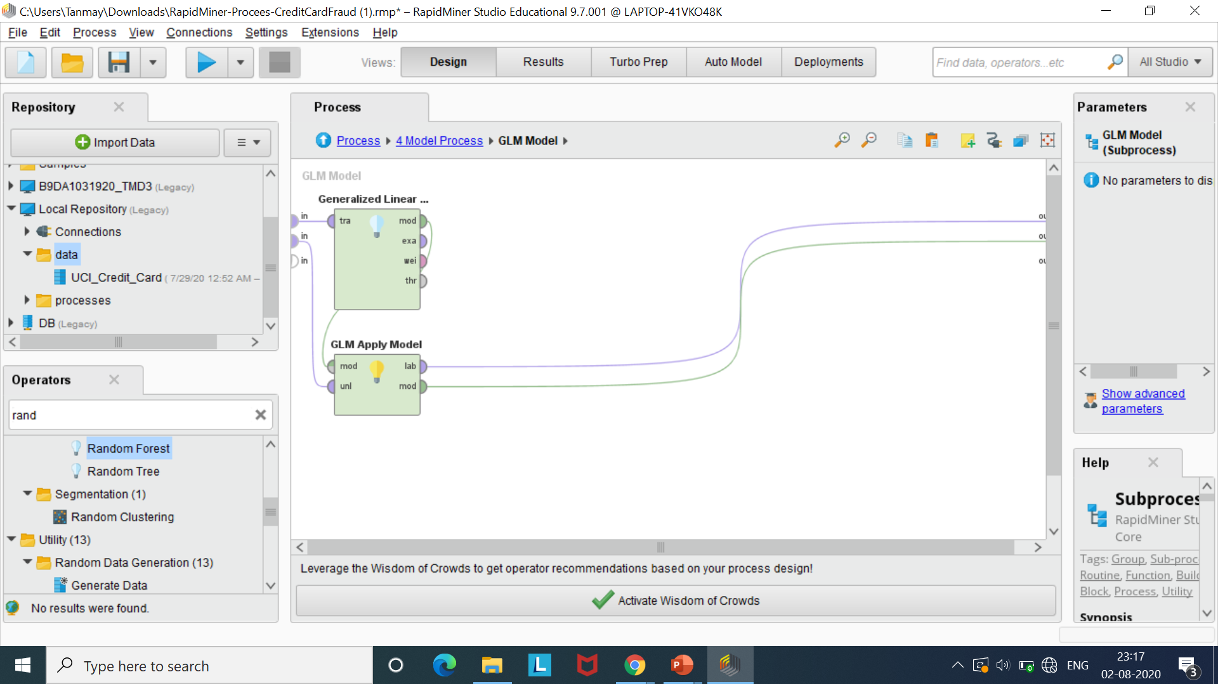
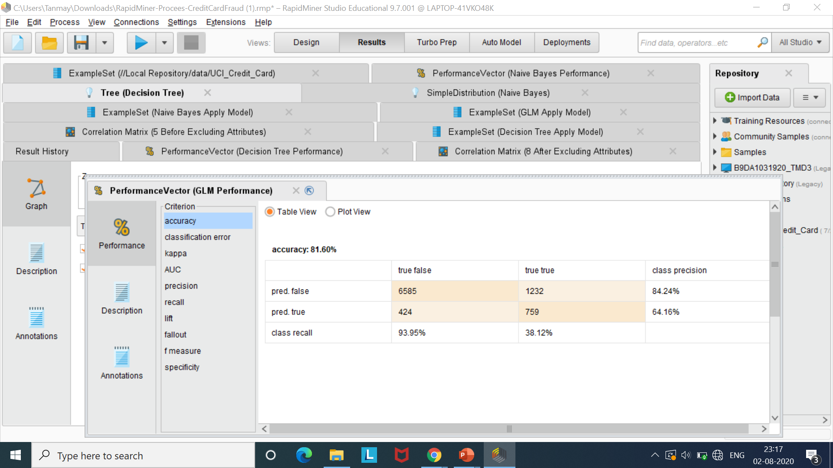
Evaluation - Performance of Generalised Linear Model
Generalised Linear Model:
Accuracy achieved by Generalised Linear Model is 81.60%

Slide 13
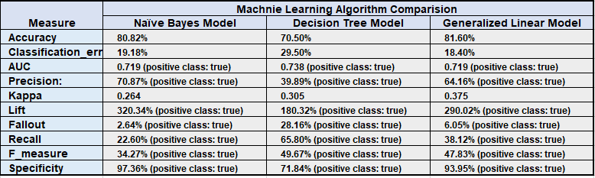
Comparison of Performance Parameter of Models used
Performance Measures of Applied Models are as follows:

Slide 14
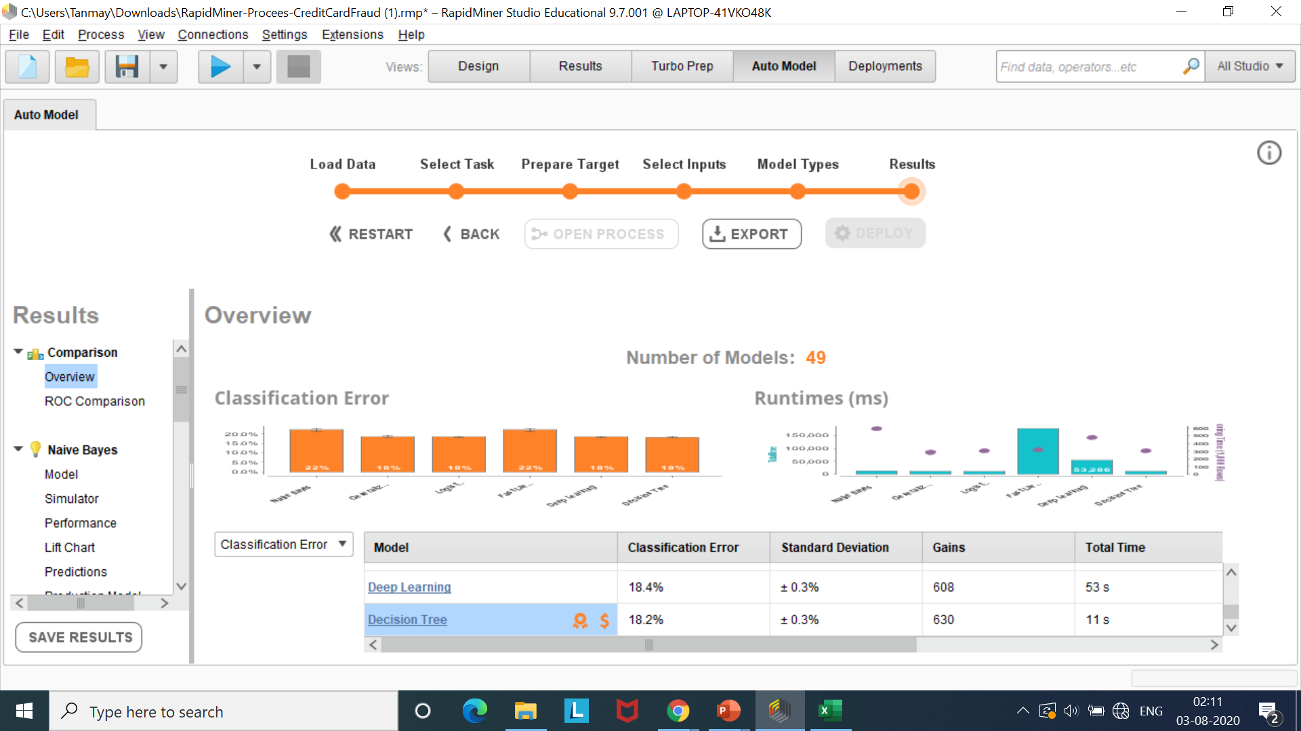
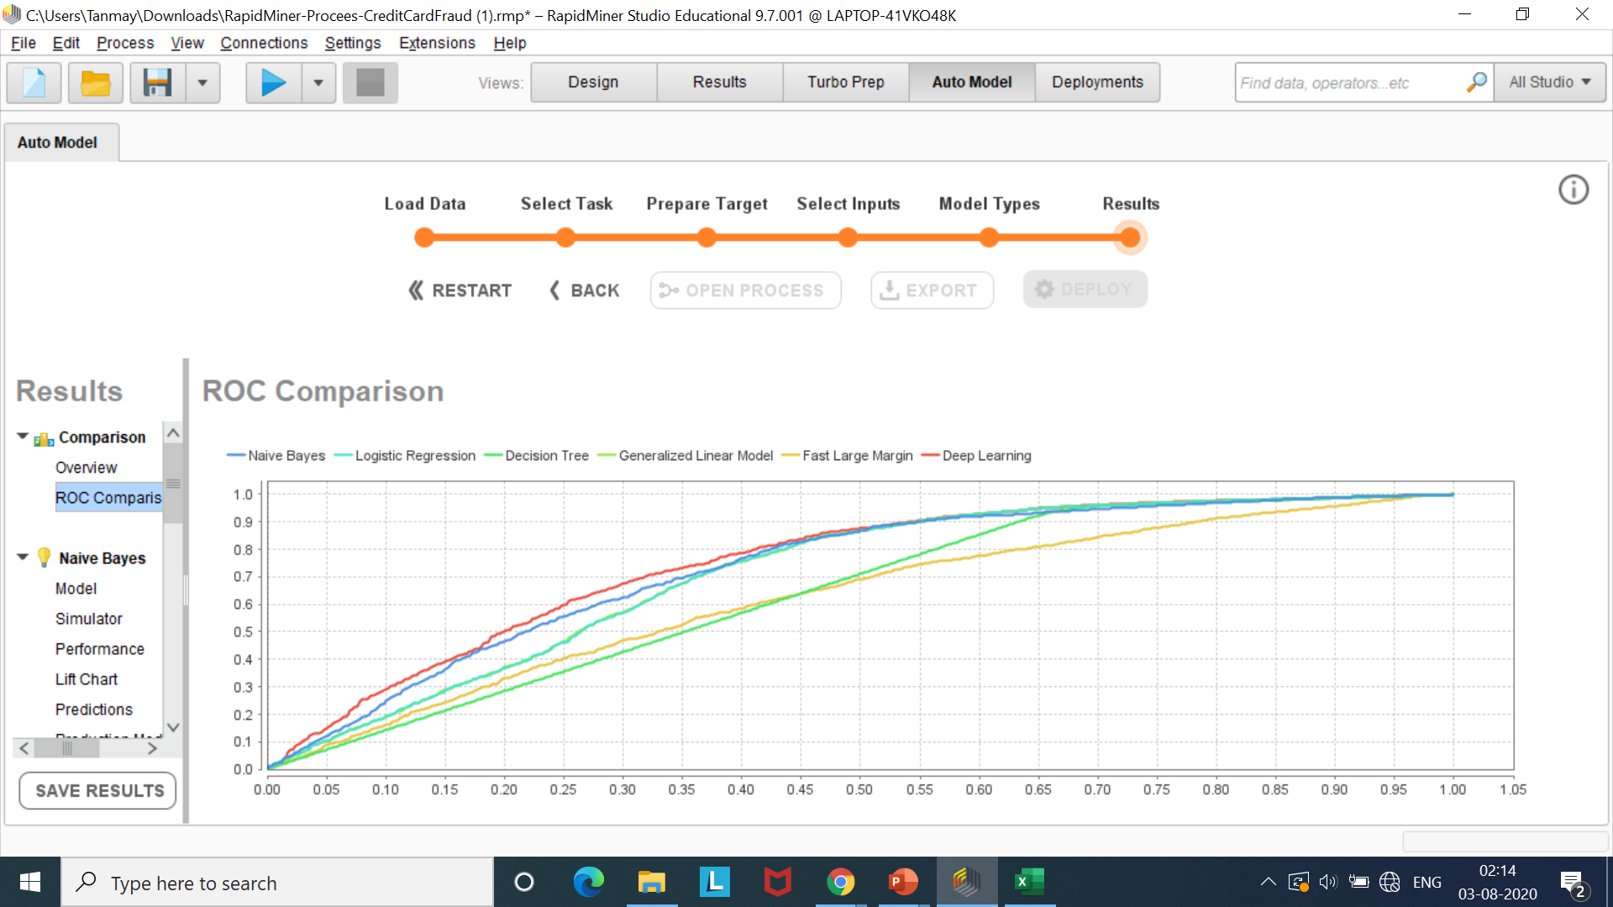
Auto Model Results

Slide 15
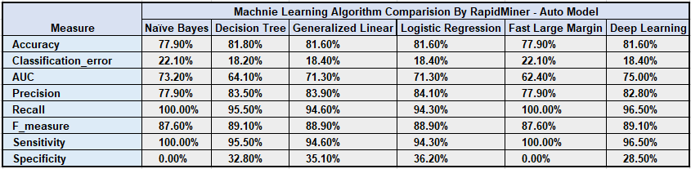
Auto Model Performance Comparison
Performance Measures of Auto model are as follows:

Slide 16
6. Deployment
Deployment:
Comparing pperformance measure of Naïve Bayes, Decision Tree and Generalized Linear Model(GLM) on basis of Accuracy and other parameter .
It is observed highest accuracy out three model is for Generalized Linear Model 81.60 % followed by Naïve Bayes 80.82 % and lowest is by Decision Tree Model 70.50 % .
Therefore Generalized Linear Model has been selected for deployment from three models tested.
Initially we will deployment model in UAT environment (User Accept Testing ) and further exhaustive testing will be done. And once solution is approved in UAT it will be deployed in Production environment of Credit Card issuing organization or Bank.

Slide 17
Conclusion
Conclusion :
While using Auto model functionality of Rapid Miner on same dataset minor increase in accuracy was observer for all three model tested in solution.
Further improvisations can be done in solution by adding data preparation step, operators and tuning parameter of each model to predict the outcome of a system which will benefit to Credit Card Issuing organisation and Banks.

Slide 18
Questions?
THANK YOU

